Slide 1
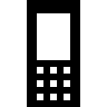

Mobile Testing
Software Quality Assurance
Telerik Software Academy
http://academy.telerik.com

Slide 2

The Lector
Miroslav Shtilianov Senior QA Engineer DevCloud Testing & Test Studio Quality Assurance Team

Slide 3
Table of Contents
Mobile – Why is it important?
Quality is critical for mobile applications
Challenges of mobile testing
Types of mobile applications
Device cloud
Types of mobile applications testing
Mobile testing strategy
Mobile testing tools architecture
Telerik mobile testing

Slide 4
Mobile – NEXT Dominant Phase of Computing
Mobile devices accounted for 55% of Internet usage
Apps made up of 47% of internet traffic
Smart phone users worldwide total 1.75 Billion
~138 billions of app downloads
Faster lifecycles
More iterative
Mobile/Wireless/Cloud

Slide 5

Quality is Critical for Mobile Applications
Customer facing applications
User experience is key to brand perception
You can’t delete negative customer reviews in the App Store/Google Play
User experience is key to brand perception

Slide 6
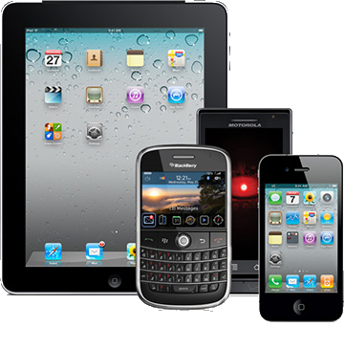
Challenges with Testing Mobile Devices
Thousands of Mobile Handsets
different screen sizes, input methods (QWERTY, touch, normal) with different hardware capabilities

Slide 7
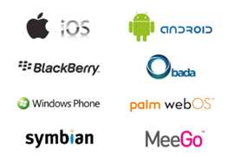
Challenges with Testing Mobile Devices (1)
Different Mobile Platforms/OS
mobile platforms, different OS versions and platform limitations
Different Mobile Carriers/Manufacturers
every manufacturer may have some norms regarding the mobile application

Slide 8

Challenges with Testing Mobile Devices (2)
New Capabilities to test
Camera, GPS, voice
Data and power consumption
Wearables
Non-Functional testing
Backward Compatibility

Slide 9
Types of Mobile Applications
Native
iOS (ObjectiveC, Swift)
Android (Java)
Windows Phone (C#)
Hybrid
Web apps that run on the device inside a native container
Render HTML and process java script on the device
Enables access to the device capabilities (camera, gps)
Web
Server side apps styled for mobile consumption
Mobile web browsers

Slide 10

Device Cloud
What is a device cloud?
Providers
Bitbar
Etherios
Xamarin cloud

Slide 11
Types of Mobile App Testing
Manual | Automated
Functional Testing | Performance testing
Memory Leakage testing | Memory Leakage testing
Interrupt testing | Interrupt testing
Usability testing | Certification testing
Installation testing

Slide 12
Mobile Testing Strategy
Don’t test everything
analyze your app, goals and target audience to decide on the top 10 combinations
Build, configure and maintain a proper mobile test lab
Plan for integration testing
web app and mobile app use the same backend
Don’t use emulators for test execution
customers does not use emulators
Use test automation

Slide 13

Mobile Testing Tools Architecture
Selendroid example
Prerequisites
Selendroid server and iOS driver
Java SDK
Android SDK + adb tools
Maven
Selenium 2.0
IDE (Eclipse, intelij or other)

Slide 14
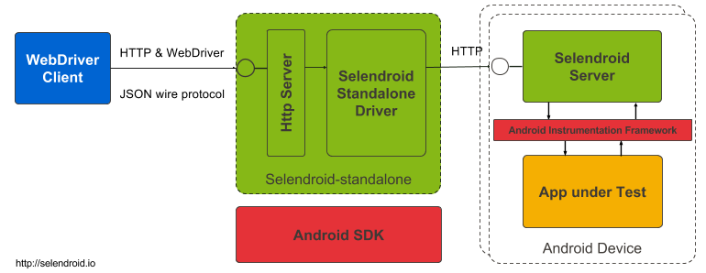
Selendroid's Architecture
Selendroid-Client – the java client library (based on the selenium java client)
Selendroid-Server – that is running beside your app on the Android device
AndroidDriver-App – a built in Android driver webview app to test the mobile web
Selendroid-Standalone – manages different Android devices by installing the selendroid-server and the app under test

Slide 15
Telerik Mobile Testing
Message Server
Mobile Testing Client
Mobile Testing Extension
App Under Test
CLI/Web Runner
Device/Emulator

Slide 16
Mobile Testing
?
?
?
?
?
Questions?
?
?
?
?
?
?

Slide 17




Free Trainings @ Telerik Academy
C# Programming @ Telerik Academy
csharpfundamentals.telerik.com
Telerik Software Academy
academy.telerik.com
Telerik Academy @ Facebook
facebook.com/TelerikAcademy
Telerik Software Academy Forums
forums.academy.telerik.com

